Slide 1


Slide 2
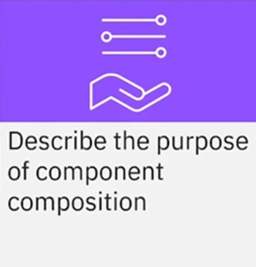
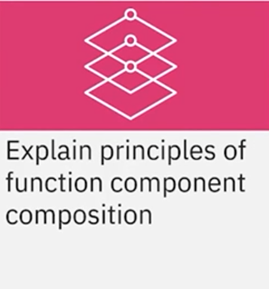
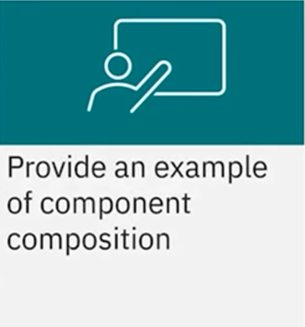
What you will learn

Slide 3



Combine components
Create complex UI

Slide 4
Composition principles
Abstraction
Hierarchy
Higher-order component(HOCs)
Reusuability
Props and children

Slide 5
Abstraction principles

Slide 7
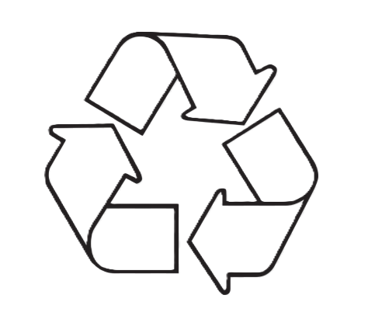
Reuse principle

Slide 8
Hierarchy principle
Parent
Children
Children
Children

Slide 9
Props and children principles
Data flow :
From parent to child
Pass a component into another one
Parent
Parent
Props data
Child
Child

Slide 10
Higher-order components(HOCs)
Function

Slide 11
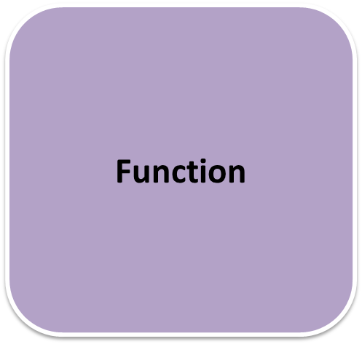
Higher-order components(HOCs)

Slide 12

Use case
Blog for novels
Features:
Title
Author
Type
Description

Slide 13
Recap
In this lesson, you learned that: • You use component composition to combine smaller components to create a complex UI • Principles of component composition include:
Abstraction
Reusability
Hierarchy
Props and children
Higher-order components

